Slide 1
An annotation framework for Fedora
Andrew Ashton
Brown University Library

Slide 2
Textual scholarship at Brown
Brown University Women Writers Project
Virtual Humanities Lab
Center of Digital Epigraphy
Modernist Journals Project
Hypertext, CAVE Writing, etc.

Slide 3
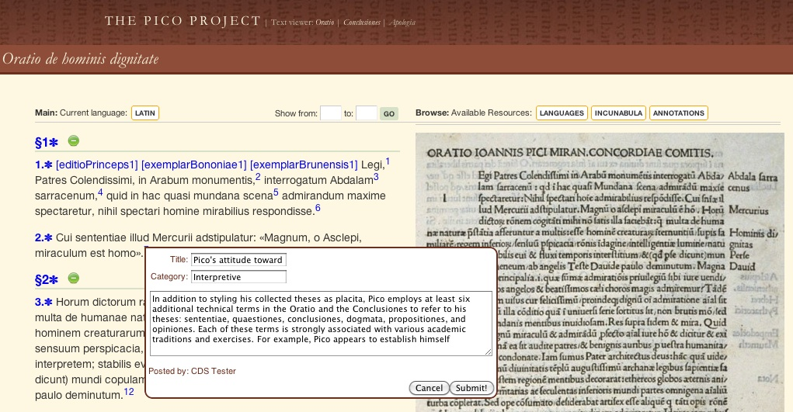
The Pico Project

Slide 4
Giovanni Pico della Mirandola’s 900 Theses (1486)

Slide 5
The Brown Digital Repository (BDR) is a place to gather, index, preserve, and make available digital assets of enduring value produced via academic and research activities at Brown.
https://repository.library.brown.edu

Slide 6
Self-service web app:
Upload
Tag
Annotate
Share
Describe
https://repository.library.brown.edu

Slide 7
A
B
C
Annotation
Annotation
Primary
Object
Annotation
Annotation
Repository
Annotation
Annotation
Annotation
Annotation
My group’s annotations
About component “C”
My annotations

Slide 8
Open Annotation Plugin for Fedora
Requirements:
No modifications to Fedora
No content model requirements
No additional expertise
Jython web service
Create annotations and bodies (optional) – any format
Query OA data
Serialize individual annotations or by query
Listen for updates from Fedora
http://brown-university-library.github.com/oac_web_service/
http://bit.ly/oa_fedora

Slide 9
Fedora repository
OA plugin
Anno-1
Client application
Serialize
Create
Body-1
Target-1
Query
ActiveMQ
Fedora APIs

Slide 10
@prefix dc: <http://purl.org/dc/elements/1.1/> .
@prefix fedora-model: <info:fedora/fedora-system:def/model#> .
@prefix oa: <http://www.w3.org/ns/openannotation/core/> .
@prefix oax: <http://www.w3.org/ns/openannotation/extension/> .
@prefix rdf: <http://www.w3.org/1999/02/22-rdf-syntax-ns#> .
<info:fedora/test:133> a <oa:Annotation>;
oa:annotated "2012-07-26T12:35:42.282999Z";
oa:annotator "aashton@brown.edu";
oa:generated "2012-07-26T12:35:42.404999Z";
oa:generator "OAC TEI Demo web application";
oa:hasBody <info:fedora/test:132>;
oa:hasTarget <info:fedora/test:133/SpecificTarget>;
oa:modelVersion <http://www.openannotation.org/spec/core/20120509.html>;
fedora-model:hasModel <info:fedora/bdr-cmodel:oa-annotation>;
fedora-model:hasService <info:fedora/oac-sdef:serialize> .
<info:fedora/test:132> a <oa:Body>;
dc:format "text/xml" .
<info:fedora/test:133/SpecificTarget> a <oa:SpecificResource>;
oa:hasSelector <info:fedora/test:133/selector>;
oa:hasSource <info:fedora/changeme:35>;
oax:hasStyle <info:fedora/test:1000010118> .
<info:fedora/test:133/selector> a <http://www.tei-c.org/release/doc/tei-p5-doc/en/html/SA.html#SATSSR>,
<oa:FragmentSelector>;
rdf:value "string_range(/TEI[1]/text[1]/body[1]/div1[1]/div2[1]/p[16],782,25)" .

Slide 11
Create
Creates annotation objects in Fedora [via HTTP POST]
Datastreams:
Dublin Core
annotation (rdf/xml)
specifictarget (rdf/xml)
selector (rdf/xml)
Optionally, creates annotation bodies as new objects in Fedora. Annotation bodies can also be URIs for existing resources on the web. [via HTTP POST]
Indexes the RDF content of annotations objects in Jena

Slide 12
Query, Serialize, and Listen
SPARQL endpoint for querying Fedora annotation data [via HTTP POST and GET]
SPARQL XML response (other formats to come)
Serialize individual annotations, lists of annotations, or the entire repository.
RDF/XML, JSON, NT, TTL, CSV
JMS consumer to receive updates via Fedora’s ActiveMQ broker

Slide 13
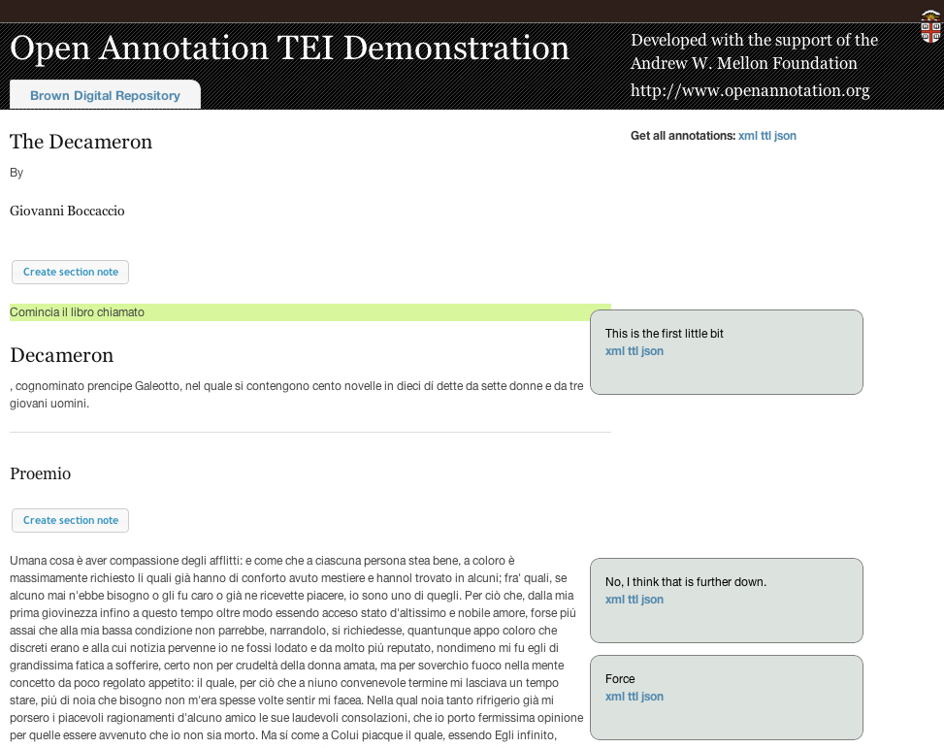
Repository annotation sandbox
Prototype application to:
Create annotations on TEI texts in Fedora
Target annotations at sections, strings, semantic markup
Create annotations as XML objects, URIs
Serialize and dump annotation repository

Slide 14
Fedora repository
Sample TEI application
1
TEI
XSLT
2
3
Anno-1
OA plugin
Query
Body-1
Target-1
4
Create
Serialize
1. Render TEI
2. Find the relevant annotations
3. Fetch and parse annotations
4. Create annotations

Slide 15
Unresolved issues
UUIDs instead of datastream URIs
Binary bodies
Multiple targets
Versioning/persistence

Slide 16
Thank you
http://bit.ly/oa_fedora
A.K.A
http://brown-university-library.github.com/oac_web_service/
Email: andrew_ashton@brown.edu
Twitters: @andyashton

